Slide 1
Chapter 4: Multithreaded programming (Class #8)
Introduction
Processes and threads
Multithreading Models
Threading Issues
Pthreads
Solaris 2 Threads
WINDOWS2000
LINUX
JAVA

Slide 2
References
Chapter 4 of Operating Systems Concepts, 8th or higher edition, Silberschatz, Galvin, Gagne, Wiley
Chapter 4, Operating systems, Fourth edition, William Stallings, Pearson education.

Slide 3

Unix Running Multiple Programs

Slide 4
Threads: introduction
Process has two characteristics
  Resource ownership
    Virtual address space is allocated
    From time to time a process may be assigned main memory plus other resources such as I/O channels, I/O devises and files.
    The OS performs a protection function to prevent unwanted interference between processes with respect to resources.
  Scheduling/execution
    The execution of a process follows an execution path (trace) through one or more programs.
    The execution can be interleaved with that of other processes.
    It is an entity that is scheduled and dispatched by the operating system.
The two characteristics are independent
  The unit of dispatching is called thread
  The unit of resource ownership is called as a process or task.
Examples: writing of file to disk
  Compute on one batch of data while reading another batch of data.

Slide 5
Multi-threading
Multithreading refers to the ability on an operating system to support multiple threads of execution within a single process.
Traditionally there is s single thread of execution per process.
  Example: MSDOS supports a single user process and single thread.
  UNIX supports multiple user processes but only support one thread per process.
Multithreading
  Java run time environment is an example of one process with multiple threads.
  Examples of supporting multiple processes, with each process supporting multiple threads
    Windows 2000, Solaris, Linux, Mach, and OS/2
Instruction
trace
One process one thread
One process multiple threads
Multiple processes,
multiple threads per process
Multiple processes,
one thread per process

Slide 6
Process and Thread
The following are associated with the process.
  A virtual address space that holds the process image.
  Protected access to processors, and others processes, files, and I/O resources (devices and channels)
Within a process there may be one or more threads, each with the following
  A thread execution state (Running, Ready, etc.)
  Individual execution state; one way to view a thread is an independent program counter operating within a process.
  Each thread has a control block, with a state (Running/Blocked/etc.), saved registers, instruction pointer
  Separate stack
  Shares memory and files with other threads that are in that process

Slide 7

Single and Multithreaded Processes
Faster to create a thread than a process
In a single threaded process model, the representation of a process includes its PCB, user address space, as well as user and kernel stacks.
  When a process is running. The contents of these registers are controlled by that process, and the contents of these registers are saved when the process is not running.
In a multi threaded environment
  There is a single PCB and address space,
  However, there are separate stacks for each thread as well as separate control blocks for each thread containing register values, priority, and other thread related state information.

Slide 8
Threads: Benefits
All the threads of a process share the state and the resources of the process.
They reside in the same address space and have access to the same data.
  When one thread alters an item of data in memory, other threads see the results whenever they access the item.
Key Benefits
  Responsiveness:
    Allow program to continue to run even a part of it is blocked or performing lengthy operation.
      Example: a multi-threaded application still allow user interaction in one thread while an image is being loaded in another thread.
  Resource sharing: application can have different threads of activity all within the address space.
  Economy:
    It takes less time to create a new thread in an existing process than to create a new process.
      10 times improvement in the speed: MAC over UNIX
      In Solaris creating a process is 30 times slower than is creating a thread and context switching is 30 times slower.

Slide 9
Threads: Benefits…
  Economy...
    It takes less time to terminate a thread than a process.
    It takes less time to switch between two threads within the same process.
    Communication is easy with threads.
      Communication between the processes required OS intervention.
      Communication between threads can be through shared memory without OS intervention.
  Scalability or Utilization of multi processor architectures
    Multithreading exploits multi-processor architectures very well
    Each thread may be running parallel on a different processor.
    A single threaded process can only run on single CPU, no matter how many are available.
    Multithreading increases concurrency.
    Single processor architecture only creates illusion of parallelism.
If there is an application or function that should be implemented as a set of related units of execution, it is far more efficient to do as a collection of threads rather than a collection of processes.

Slide 10
Examples of use of threads
Single user multiprocessing system
  Foreground/Background
    In a spreadsheet program, one thread could display menus and read user input, while another thread executes user commands and updates the spreadsheet.
  Asynchronous Processing – Backing up in background
    Design of word processor write RAM buffer to disk once in every minutes.
  Faster Execution – Read one set of data while processing another set
    A multithreaded process can compute one batch of data while reading the next batch from a device.
    One a multiprocessor system multiple threads from the same process may be able to execute simultaneously.
  Modular program structure
    Programs that involve variety of activities or a variety of resources and destinations of input and output are easier to design.

Slide 11
Thread Scheduling and dispatching
Scheduling and dispatching is done at thread level.
The actions that affect all the threads in the process should be managed at the process level.
Suspension involves swapping of address space out of memory
  Since all the threads in the process share the address space, all threads must enter the suspend state at the same time.
  Termination of a process terminates all the threads in the process.

Slide 12
Thread Scheduling and dispatching
Thread operations
  Spawn – Creating a new thread
  Block – Waiting for an event
  Unblock – Event happened, start new
  Finish – This thread is completed
Generally a thread can block without blocking the remaining threads in the process
  Allow the process to start two operations at once, each thread blocks on the appropriate event
Must handle synchronization between threads
System calls or local subroutines
  Thread generally responsible for getting/releasing locks, etc.

Slide 13
Thread interleaving example
RPC request
RPC request
Process1
server
server
RPC using single thread
server
Thread A (process1)
Thread B (process1)
server
RPC using one thread per server

Slide 14
Multicore Programming: Challenges
Multicore or multiprocessor systems putting pressure on programmers, challenges include:
  Identifying tasks or Dividing activities
  Load Balance: Equal load on every core
  Data splitting
  Data dependency
  Testing and debugging
Parallelism implies a system can perform more than one task simultaneously
Concurrency supports more than one task making progress
  Single processor/core, scheduler providing concurrency

Slide 15
Multicore Programming (Cont.)
Types of parallelism
  Data parallelism – distributes subsets of the same data across multiple cores, same operation on each
  Task parallelism – distributing threads across cores, each thread performing unique operation
As # of threads grows, so does architectural support for threading
  CPUs have cores as well as hardware threads
  Consider Oracle SPARC T4 with 8 cores, and 8 hardware threads per core

Slide 16
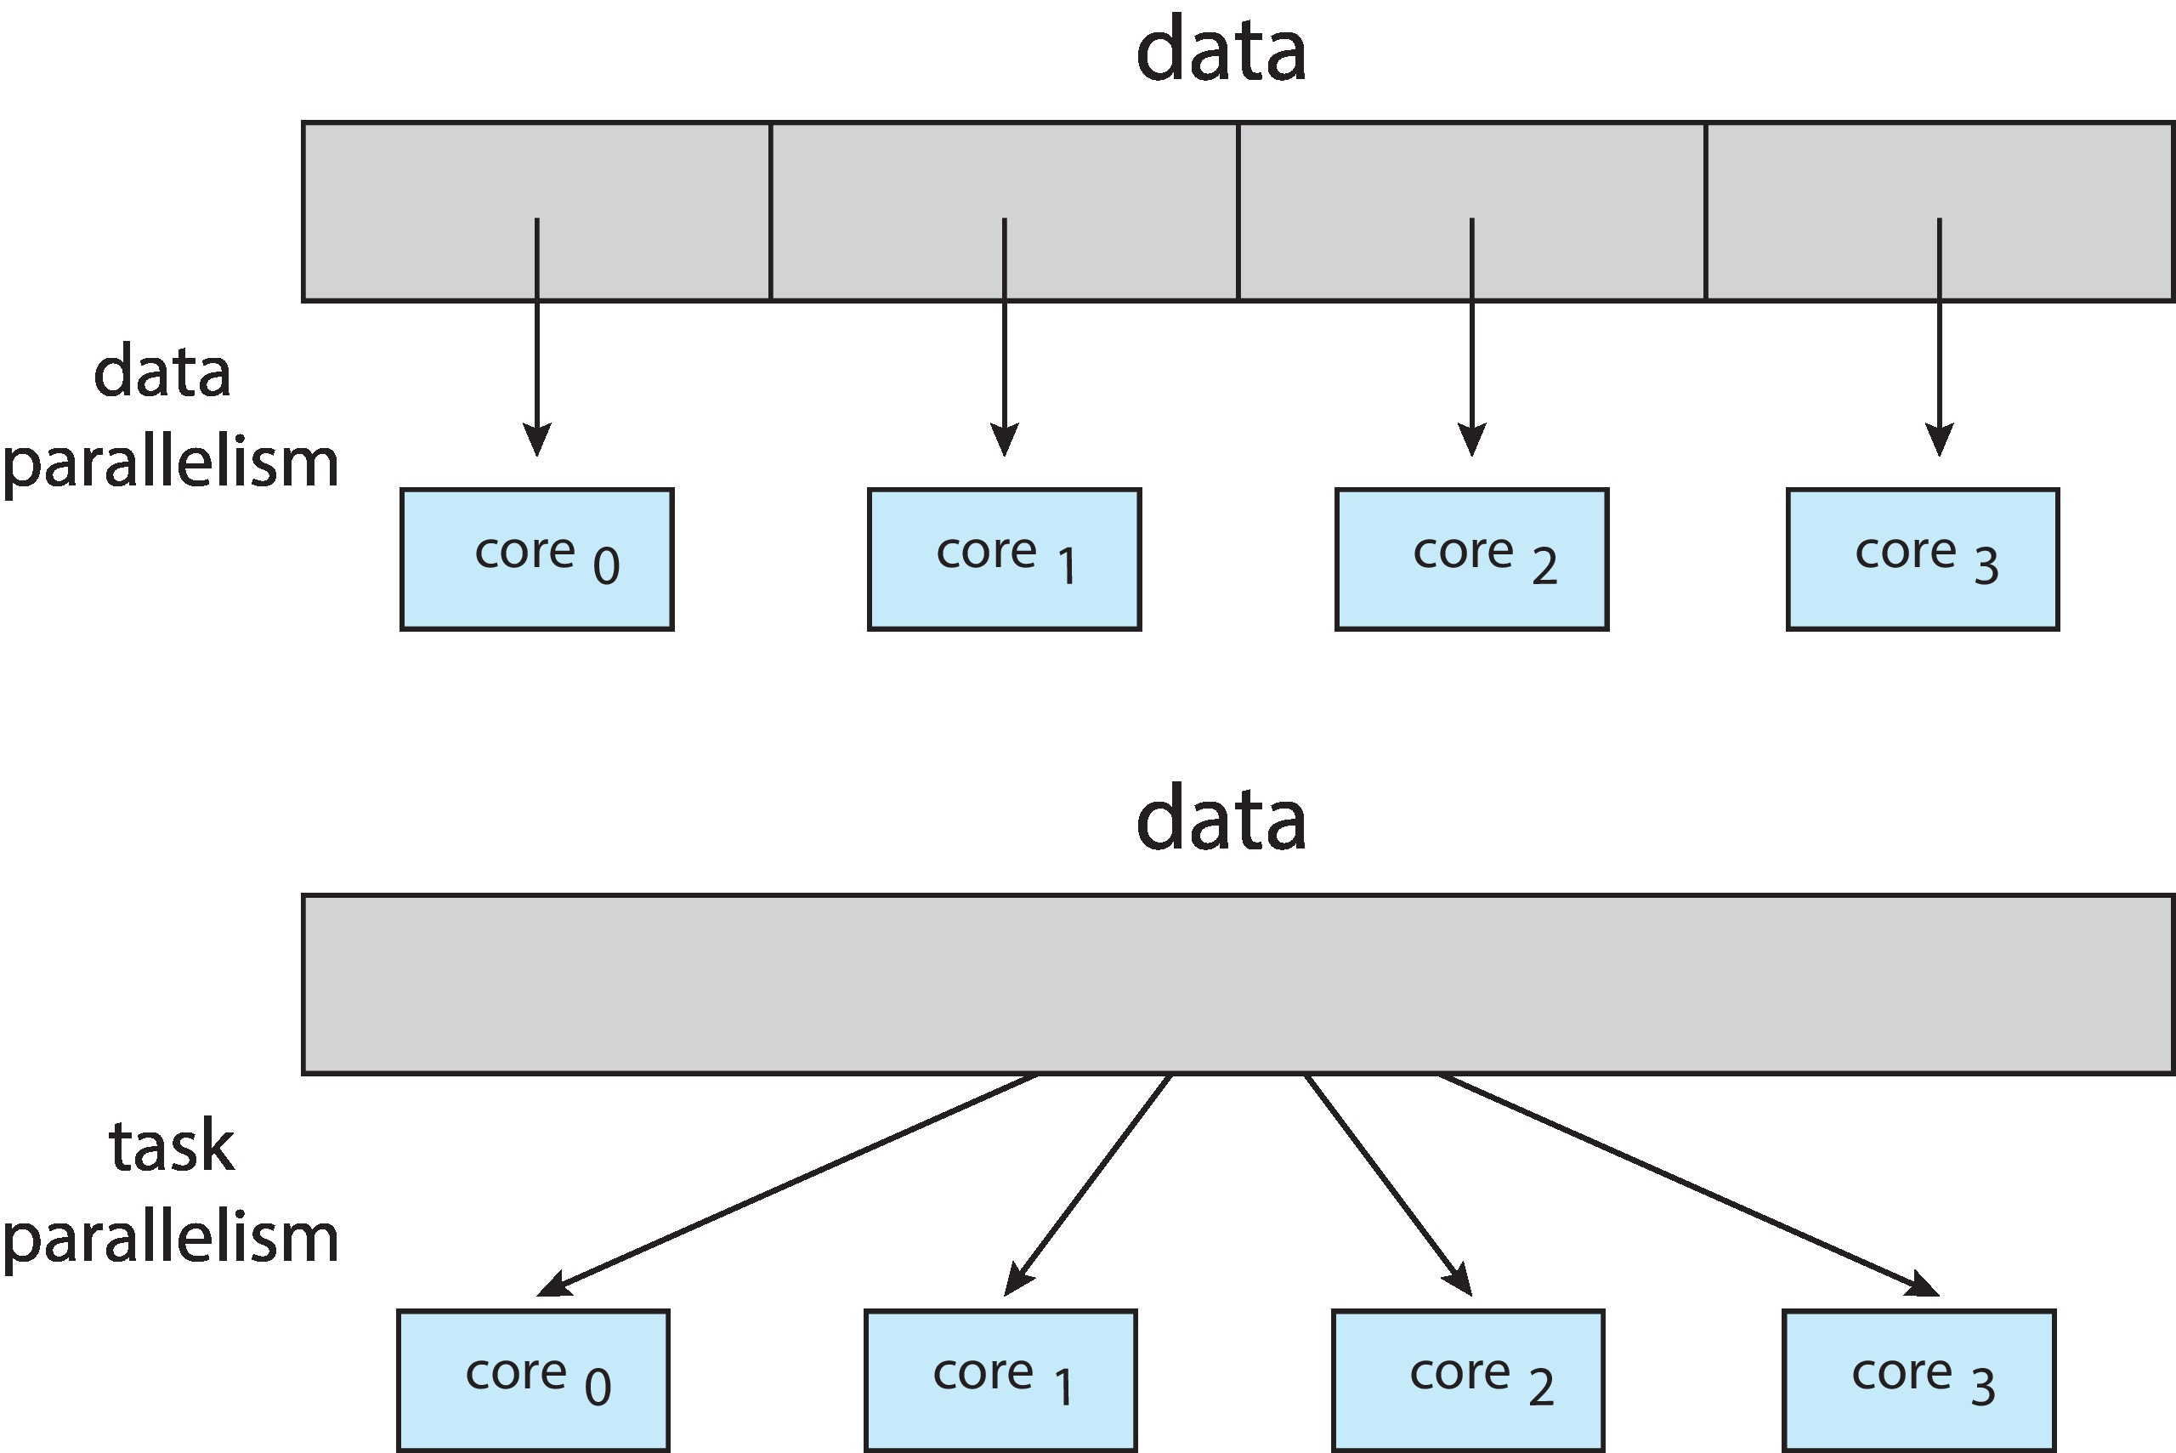
Data and Task Parallelism

Slide 17
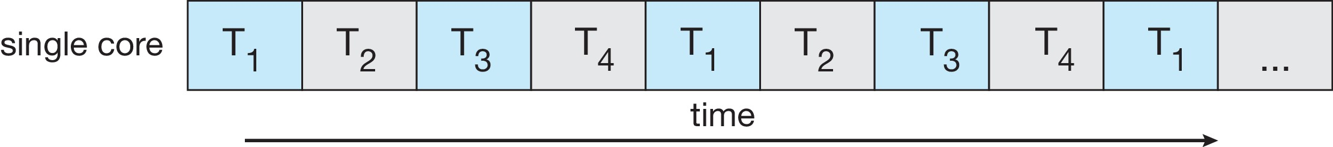
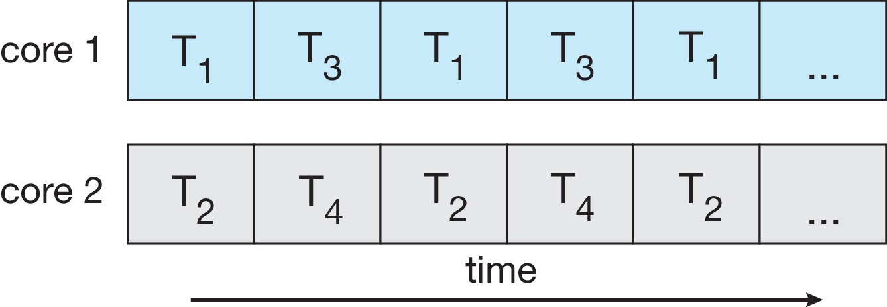
Concurrency vs. Parallelism
Concurrent execution on single-core system:
Parallelism on a multi-core system:

Slide 18

Amdahl’s Law
Identifies performance gains from adding additional cores to an application that has both serial and parallel components
S is serial portion
N processing cores
That is, if application is 75% parallel / 25% serial, moving from 1 to 2 cores results in speedup of 1.6 times
As N approaches infinity, speedup approaches 1 / S
Serial portion of an application has disproportionate effect on performance gained by adding additional cores
But does the law take into account contemporary multicore systems?

Slide 19
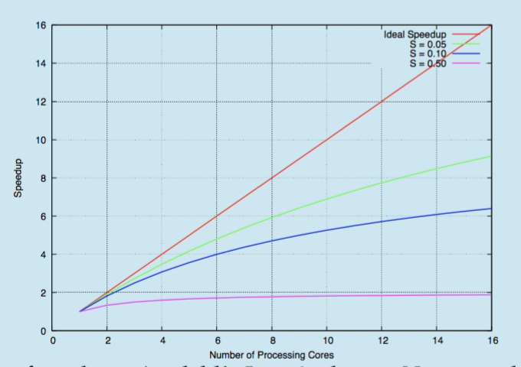
Amdahl’s Law

Slide 20
Multithreading Models
Many systems provide support for both user and kernel threads resulting different multi threading models. The following are common models.
  Many-to-One
  One-to-One
  Many-to-Many

Slide 21
Managing threads
Support for threads can be provided at either user level or at kernel.
  User-level threads
  Kernel-level threads

Slide 22
User-level Threads
Thread management is done by user-level threads library
Application creates/manages all threads using a library
System schedules the process as a unit
  Scheduling, etc. is all in user space (faster)
  Scheduling can be application specific
  Does not require O.S. support
Has problems with blocking system calls
Cannot support multiprocessing
Examples
- POSIX Pthreads
- Mach C-threads
- Solaris threads

Slide 23
Kernel-level Threads
Supported by the Kernel
Kernel handles managing threads
Easier to support multiple processors
Kernel itself may be multithreaded
Need user/kernel mode switch to change threads
Examples
- Windows 95/98/NT/2000
- Solaris
- Tru64 UNIX
- BeOS
- Linux
Other Approaches
  Each kernel thread may have multiple user threads

Slide 24

Many-to-One
Many user-level threads mapped to single kernel thread.
Thread management is done in user space.
Entire process will block if a thread makes a blocking system call.
Used on systems that do not support kernel threads.

Slide 25

One-to-One
Each user-level thread maps to kernel thread.
Provides more concurrency than many-one model
Allows other thread to run if a thread makes blocking system call
Drawback: creating user thread requires creating the corresponding kernel thread.
Most systems restrict the number of threads supported by the system
Examples
- Windows 95/98/NT/2000
- OS/2

Slide 26

Many-to-Many Model
Allows many user level threads to be mapped to many kernel threads.
Allows the operating system to create a sufficient number of kernel threads.
When thread performs a blocking system call, the kernel can schedule another thread for execution.
Solaris 2 and Windows NT/2000 with the ThreadFiber package

Slide 27
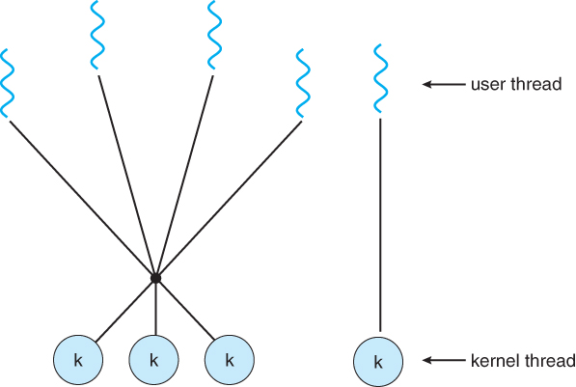
Two-level Many to Many model
Allows
  multiplexing of many user-level threads to a small number or equal number of kernel threads, and
  User level thread to be bound to a kernel thread

Slide 28
Threading Issues
Some of the issues to be considered for multi-threaded programs
  Semantics of fork() and exec() system calls.
  Thread cancellation.
  Signal handling
  Thread pools
  Thread-specific data

Slide 29
Threading Issues…
Semantics of fork() and exec() system calls.
  In multithreaded program the semantics of the fork and exec systems calls change.
  If one thread calls fork, there are two options.
    New process can duplicate all the threads or new process is a process with single thread
    Some systems have chosen two versions of fork.
Thread cancellation.
  Task of terminating thread before its completion
    Example: if multiple threads are searching database, if one gets the result others should be cancelled.
  Asynchronous cancellation
    One thread immediately terminates the target thread.
  Deferred cancellation
    The target thread can periodicallly check if it should terminate.

Slide 30
Threading Issues: Signal handling
A signal is used in UNIX systems to notify a process that a particular event has occurred.
A signal may be received synchronously or asynchronously.
All signals follow specific patterns
  A signal is generated by the occurrence of a particular event.
  A generated signal is delivered to a process
  On delivered, the signal must be handled.
Examples: illegal memory access or division by zero.
In single threaded program, it is easy, But in multithreaded program several options exist.
  Deliver a signal to specific thread
  Deliver a signal to every thread in the process
  Deliver the signal to certain threads in the process.
  Assign a specific thread to receive all signals for the process.
    Solaris 2
It depends on the type of the signal
  (<control>C) should be sent to all the threads.

Slide 31
Threading Issue: Thread pools
Consider a scenario of multithreading a web server.
Whenever a server receives a request, it creates a separate thread.
  First problem is creating thread before hand and discarding it after completion.
  Second problem is unlimited threads could exhaust system resources such as CPU time and main memory.
One solution to this issue is thread pools
  The idea is create a number of threads at process startup and place them in a pool, where they sit and wait for work.
  If the pool has no available thread, the server waits until one is free.
Benefits:
  It is faster to service with an exiting thread than waiting to create a new thread.
  A thread pool limits the number of threads at any point which is important on systems that can not support a large number of concurrent threads.

Slide 32
Threading Issues: Thread specific data
Threads share the data
Sharing is one of the benefits of multiprogramming.
However, each thread might needs own copy of certain data in some circumstances.
Such data is called thread-specific data.
  For example in transaction processing system, each transaction may be assigned a unique number.
  To associate each thread with its unique identifier, we could use thread specific data.

Slide 33
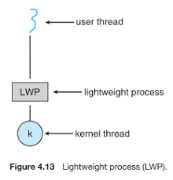
Threading Issues: Scheduler activations
Communication between the kernel and the thread library.
In many to many model, intermediate data structure is placed between kernel and user-level threads.
To the user-thread library, the LWP appears to be a virtual processor on which the application can schedule a user thread to run.
If the kernel thread blocks, the LWP blocks as well.
Typically, the application requires many LWPs run efficiently.
  One LWP is required for each concurrent blocking system call.
  Suppose, five file reads occur concurrently, five LWPs are needed. If the process has four LWPs, then fifth must wait for one of the LWPs.

Slide 34
Threading Issues: Scheduler activations
For communication, the scheme “scheduler activation” is used.
Scheduler activation: upcalls
  The kernel informs application about certain events wich is called upcall procedure
  Upcalls are handled with thread library “upcall handler”
  The kernel makes an upcall to the application regarding blocking of thread.
  The upcall handler saves the state of blocking thread relinquishes the virtual processor on which blocking thread is running.
  The upcall handler schedules another thread.
  When a waiting event occurs, the kernel makes another upcall to the thread library, informing it that the previously blocked thread is now eligible to run.

Slide 35
Pthreads
a POSIX (Portable Operating System Interface for uniX) standard (IEEE 1003.1c) API for thread creation and synchronization.
API specifies behavior of the thread library, implementation is up to development of the library.
Common in UNIX operating systems.
  MULTICS: Multiplexed Information and Computing System
  UNICS: Uniplexed Operating and Computing System
  UNICS ➔ UNIX
  LINUX: A UNIX- like operating system named after Linus Torvalds (Norwegian programmer) who initiated the work. LINUX is free and source code is open. Anyone can work on LINUX and post new code to improve it.

Slide 36
Solaris threads
Implements Many-to-Many mapping
Solaris uses four thread related concepts:
  Process: Normal Unix process which includes user’s address space, stack, and PCB
  User-level threads((ULTs): Implemented through a thread library through the address of a process. These are invisible to OS.
  Lightweight processes (LWP): mapping between ULTs and kernel threads.
    Each LWP supports one or more ULTs and maps to one kernel thread. LWPs can be scheduled independently.
  Kernel threads: These are fundamental entities that can be scheduled and dispatched to run on one of the system processors.

Slide 37

Solaris 2 Threads

Slide 38
Data structures of Solaris threads
A user level thread contains a thread ID; register set, stack and its priority. None of these are kernel resources. All exists in user space.
An LWP has a register set for the user-level thread it is running, as well as memory and account information.
  A LWP is a kernel data structure and it resides in kernel space.
A kernel thread has only a small data structure and a stack. The data structure includes
  a copy of the kernel registers,
  a pointer to the LWP to which it is attached,
  priority and scheduling information.

Slide 39

Solaris Process

Slide 40
Windows Threads
Windows API – primary API for Windows applications
Implements the one-to-one mapping, kernel-level
Each thread contains
  A thread id
  Register set representing state of processor
  Separate user and kernel stacks for when thread runs in user mode or kernel mode
  Private data storage area used by run-time libraries and dynamic link libraries (DLLs)
The register set, stacks, and private storage area are known as the context of the thread

Slide 41
Windows Threads (Cont.)
The primary data structures of a thread include:
  ETHREAD (executive thread block) – includes pointer to process to which thread belongs and to KTHREAD, in kernel space
  KTHREAD (kernel thread block) – scheduling and synchronization info, kernel-mode stack, pointer to TEB, in kernel space
  TEB (thread environment block) – thread id, user-mode stack, thread-local storage, in user space

Slide 42
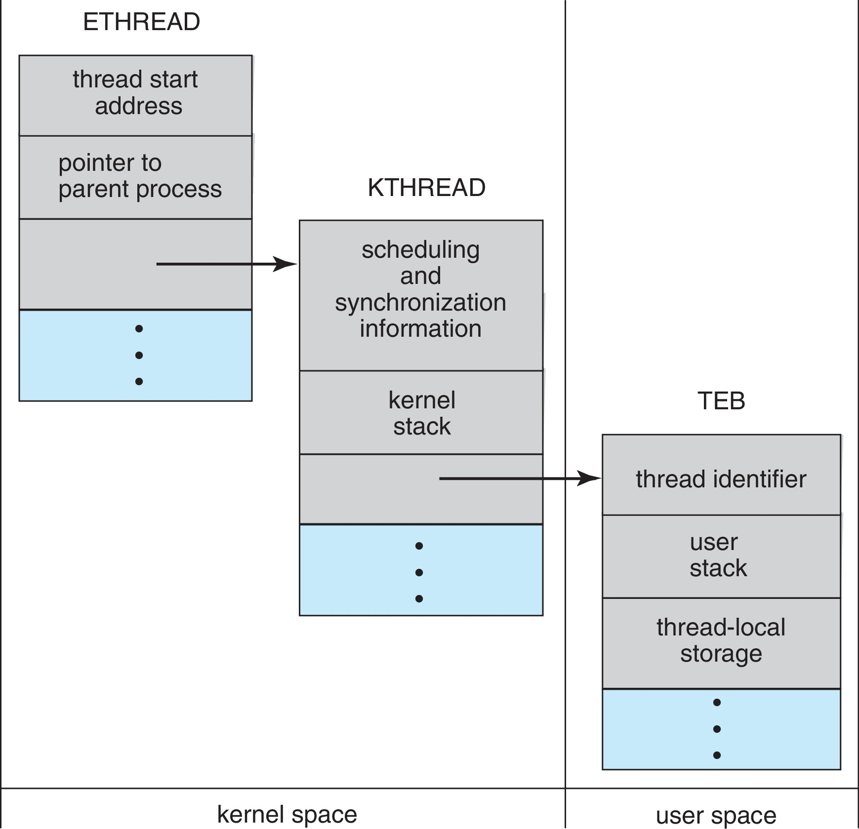
Windows Threads Data Structures

Slide 43
Linux Threads
Linux refers to them as tasks rather than threads.
Thread creation is done through clone() system call.
Clone() allows a child task to share the address space of the parent task (process)

Slide 44
Java Threads
Java threads may be created by:
  Extending Thread class
  Implementing the Runnable interface
Java threads are managed by the JVM.
Difficult to classify as a user or kernel threads.

Slide 45

Java Thread States

